Slide 1
AirKitchen:
Week 12 Update
Team FoodXYZ
Mengdan Yuan, Wen Xin

Slide 2
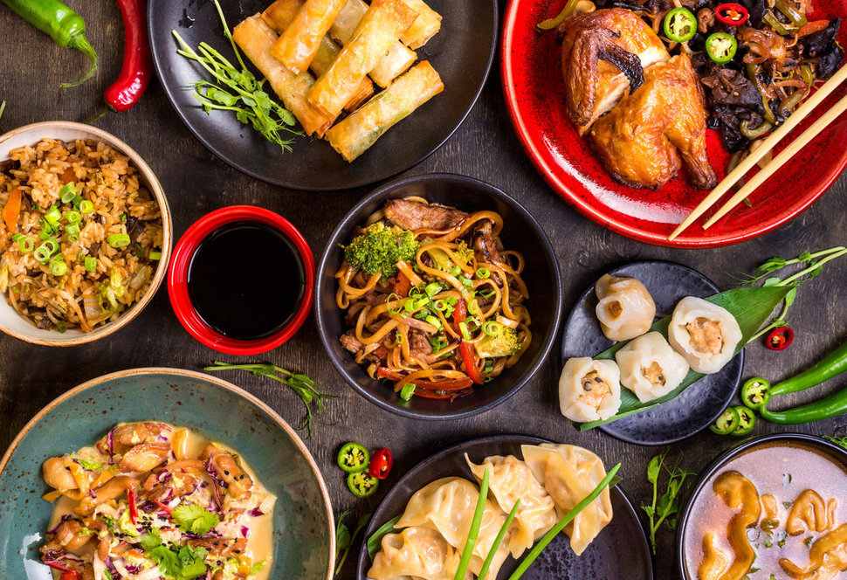
https://img.huffingtonpost.com/asset/585be1aa1600002400bdf2a6.jpeg?ops=scalefit_970_noupscale

Slide 3
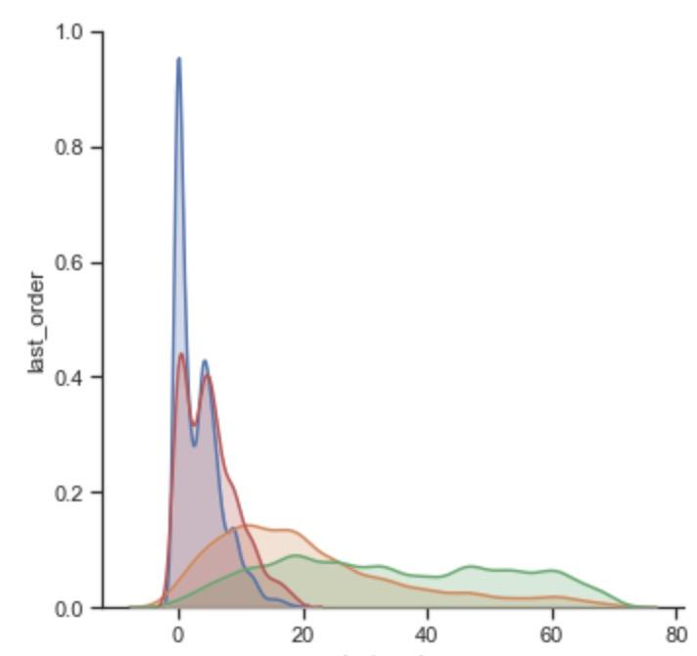
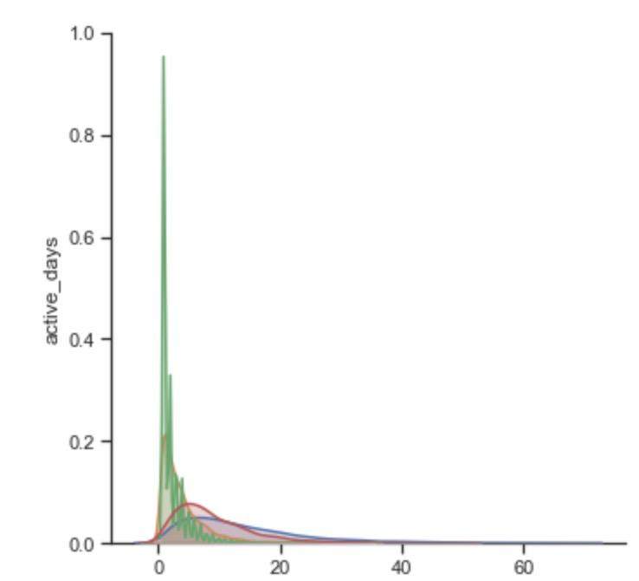
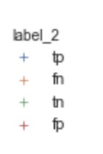
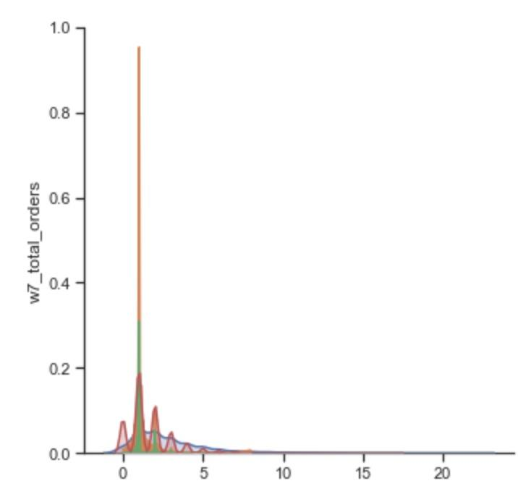
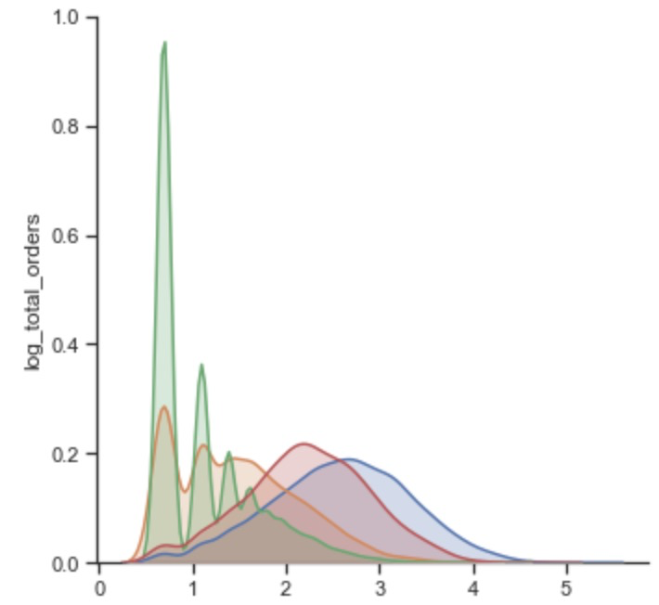
Error Analysis (features)
It seems our model is good enough :)

Slide 4
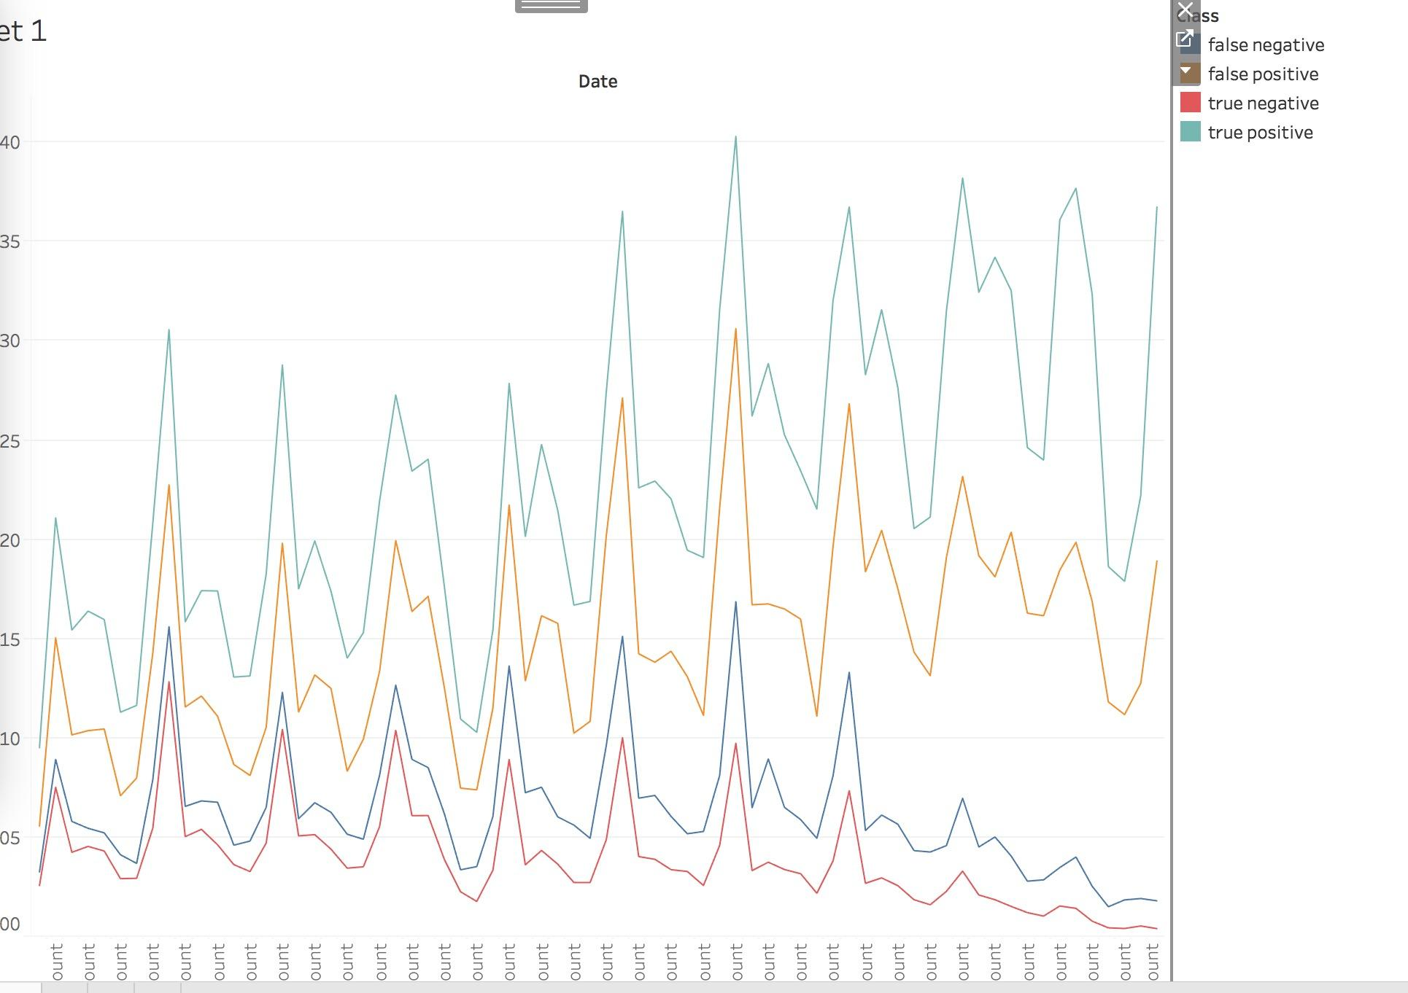
Error Analysis (daily)
It seems our model is good enough :)

Slide 5
Others
Keeping hard-working on survival analysis

